Slide 1
Powers, roots, scientific notation and BIDMAS
By Hurles

Slide 2
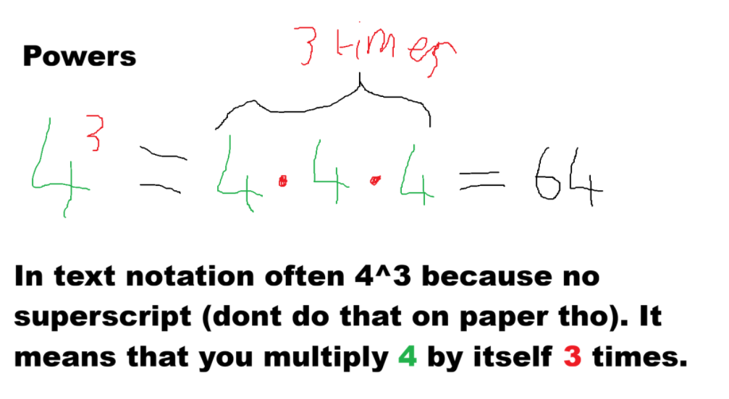

Slide 3
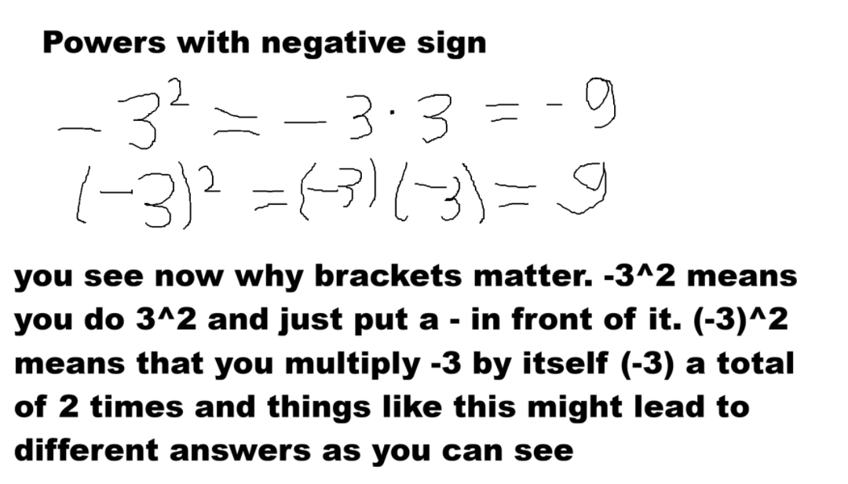

Slide 4
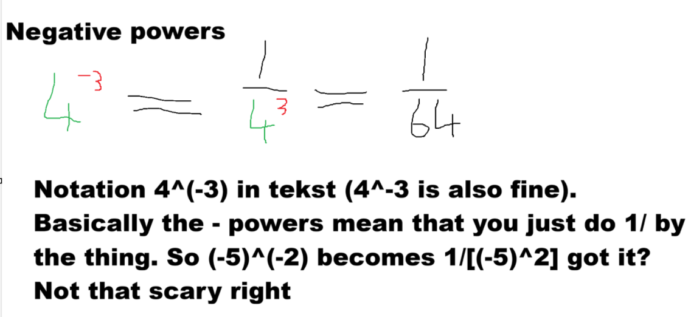

Slide 5
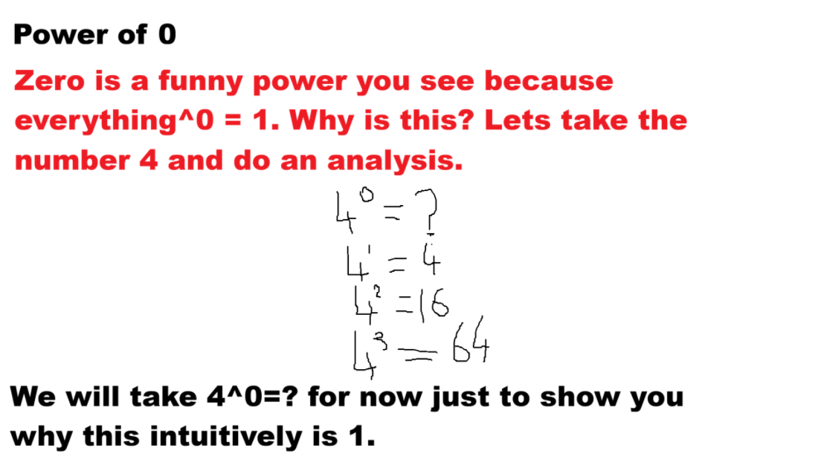

Slide 6
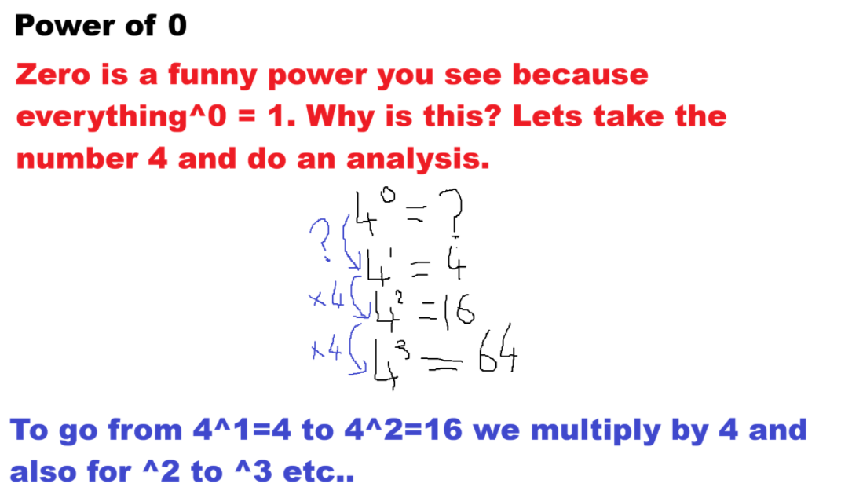

Slide 7
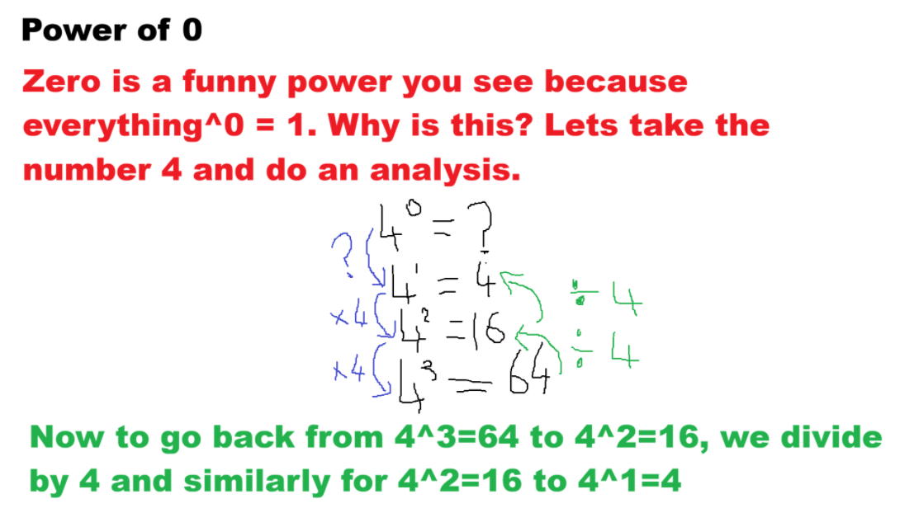

Slide 8
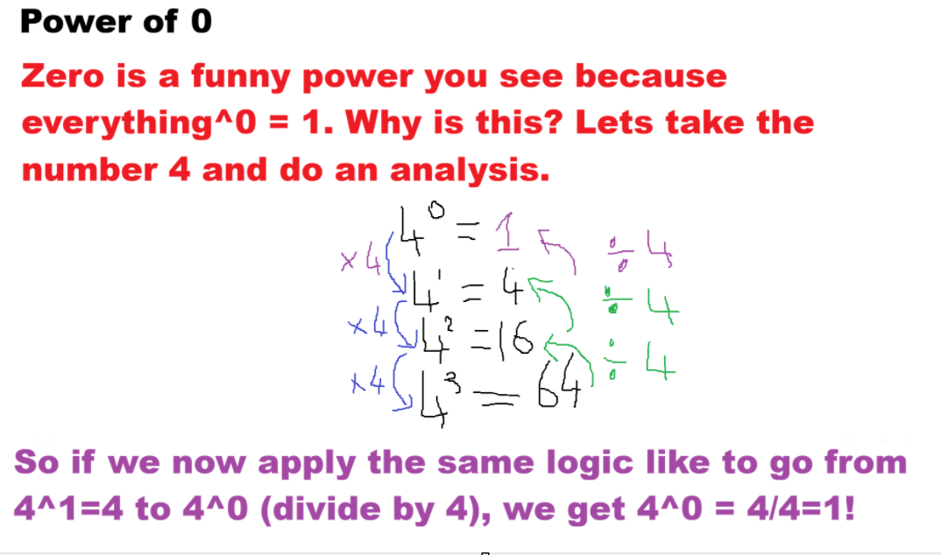

Slide 9
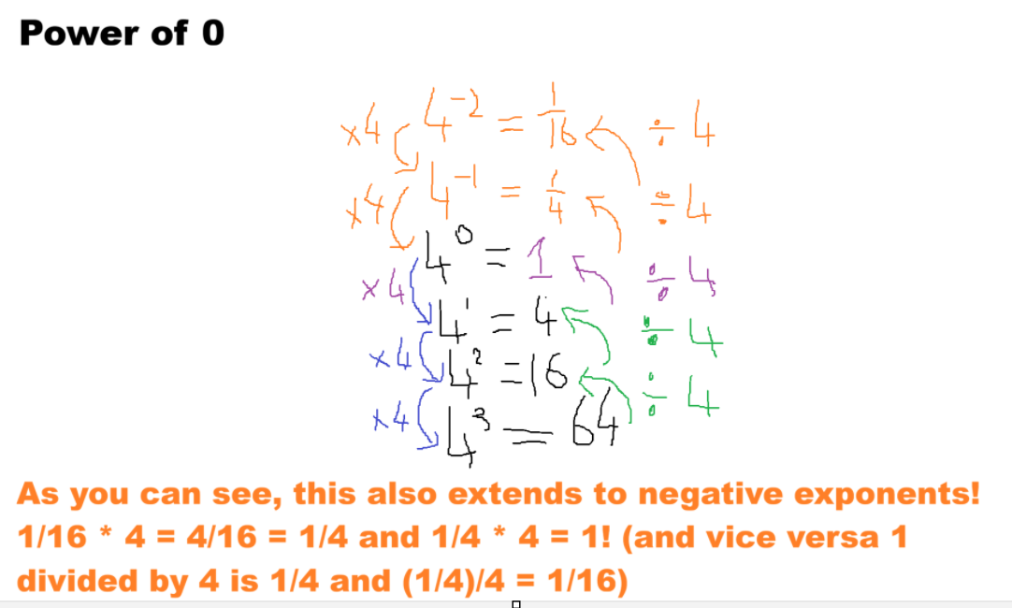

Slide 10
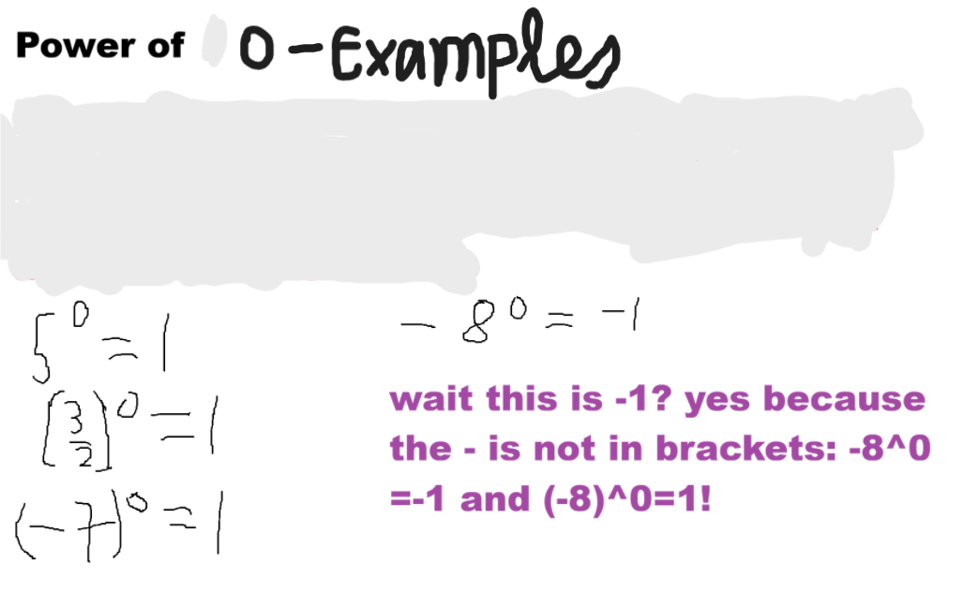

Slide 11
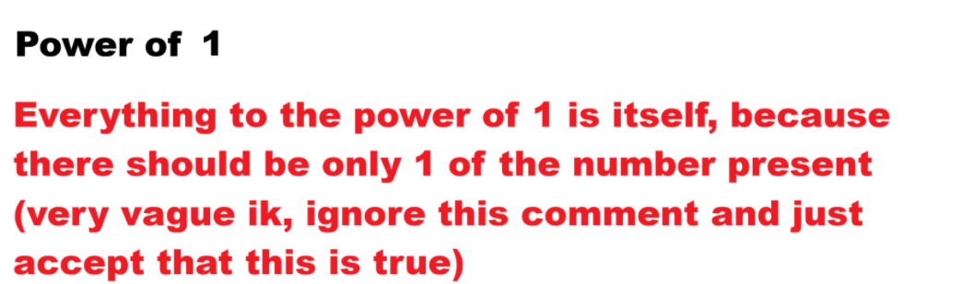

Slide 12
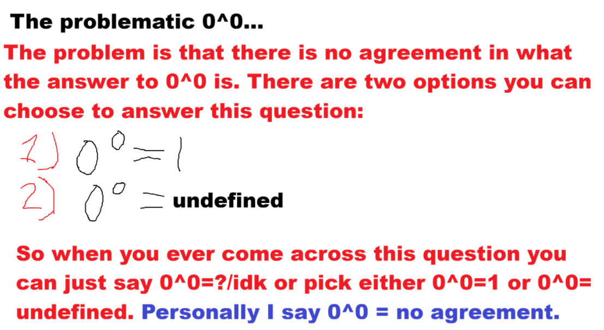

Slide 13
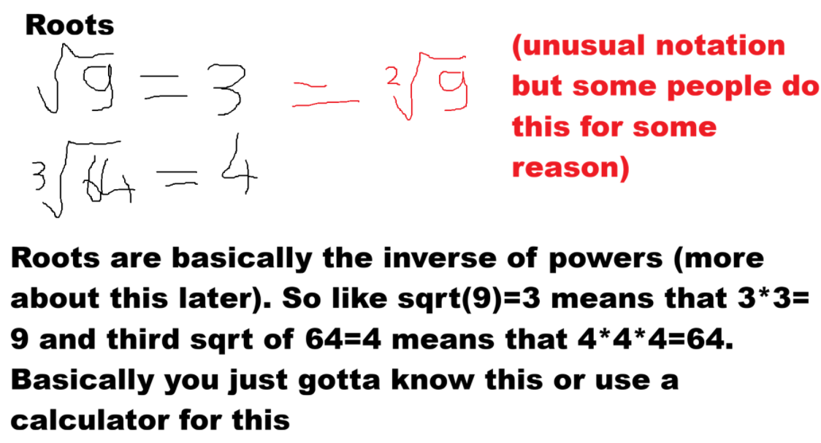

Slide 14
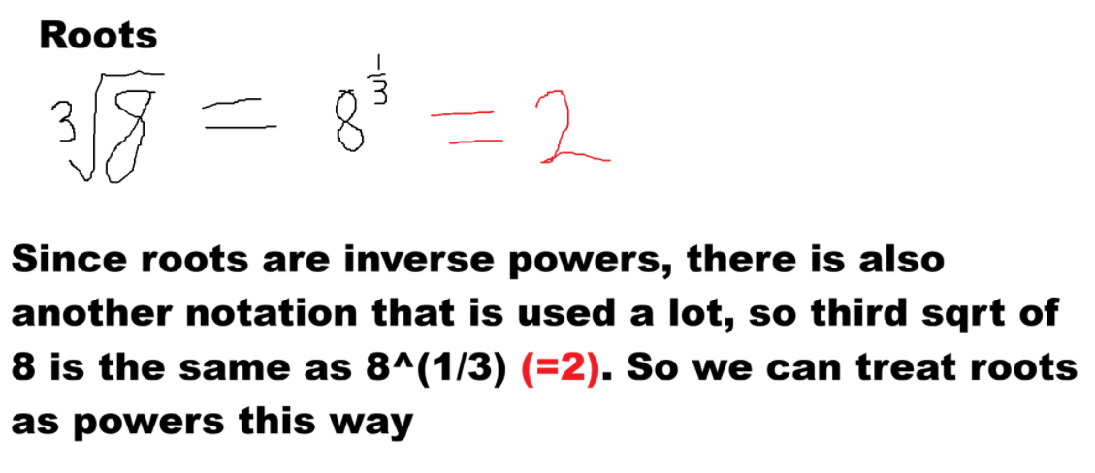

Slide 15
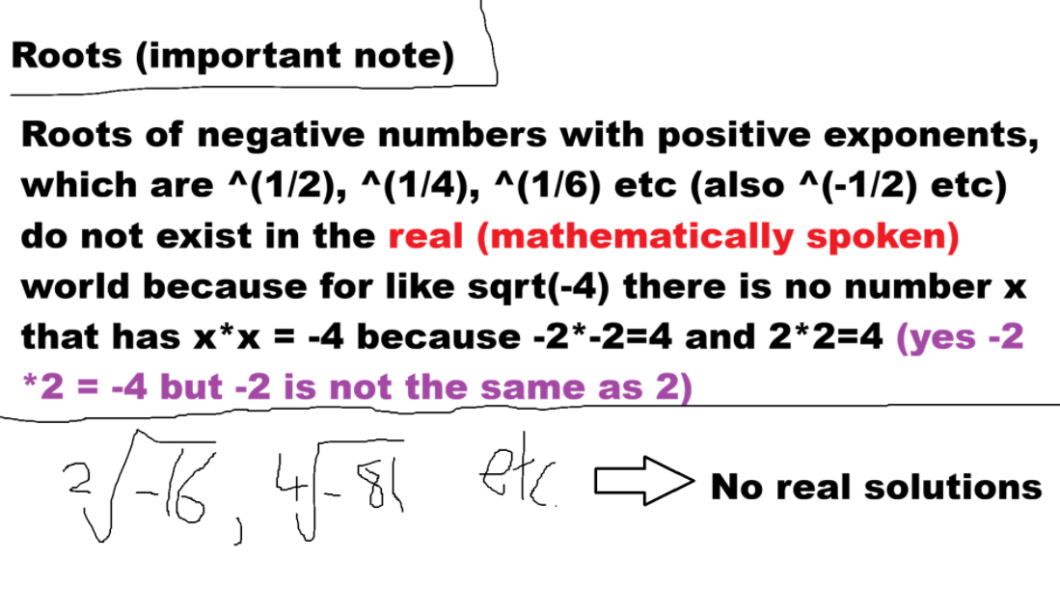

Slide 16
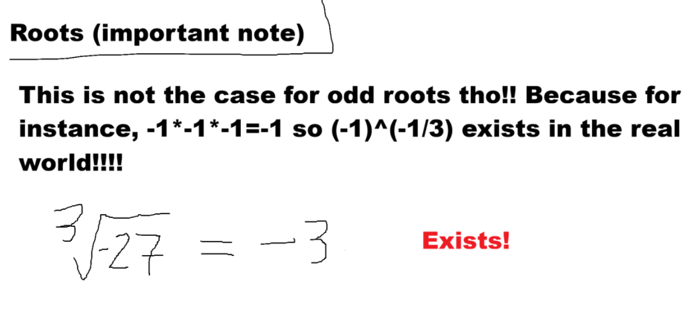

Slide 17
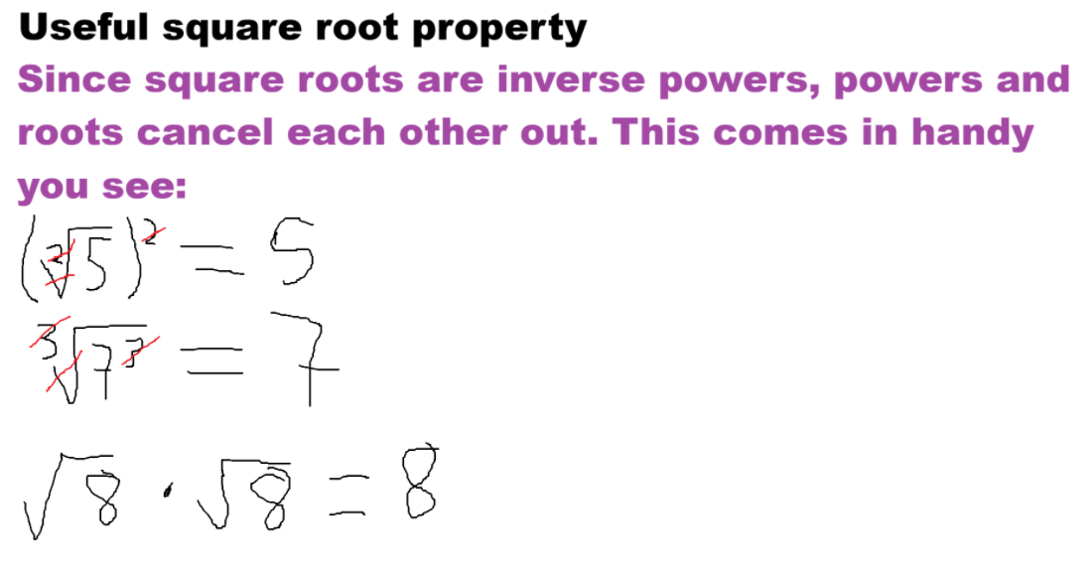

Slide 18
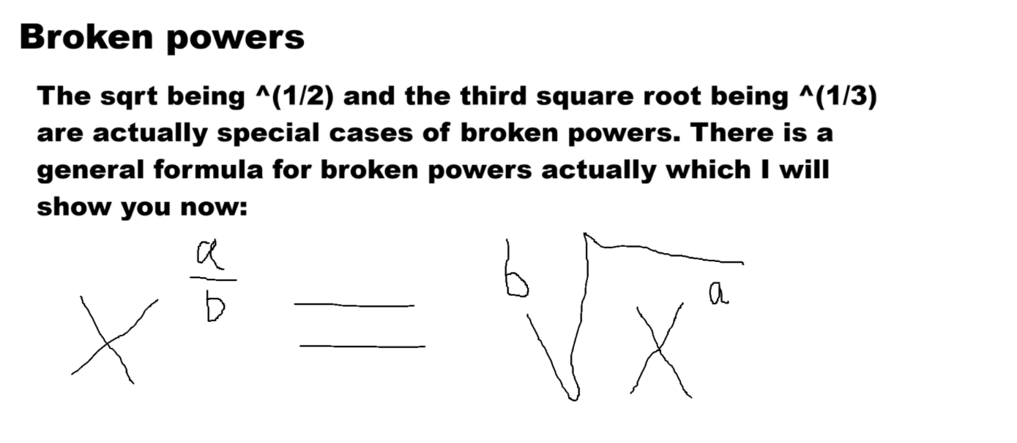

Slide 19
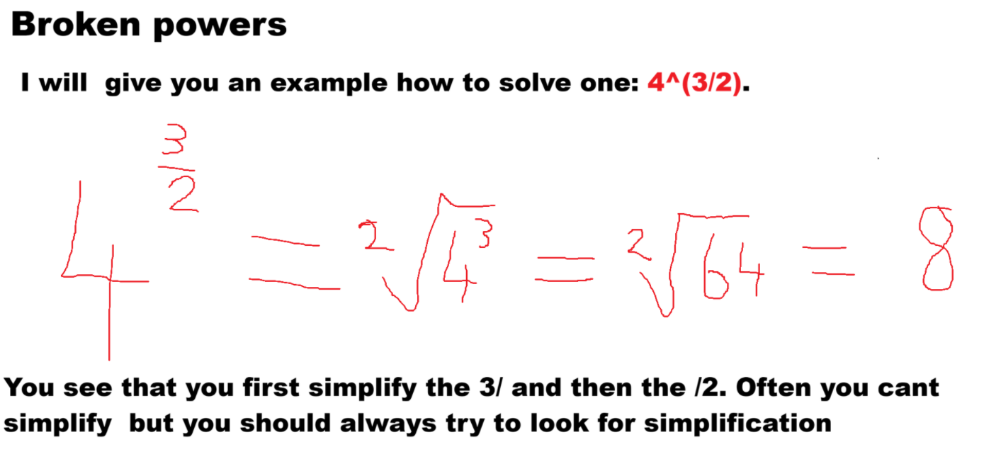
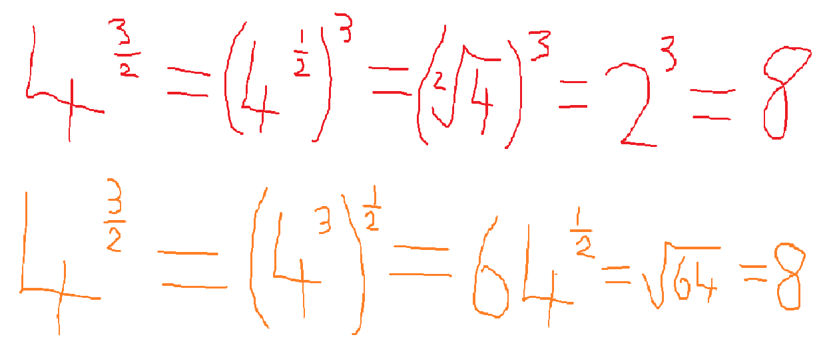
THE ORDER DOESNT MATTER AS YOU CAN SEE!

Slide 20
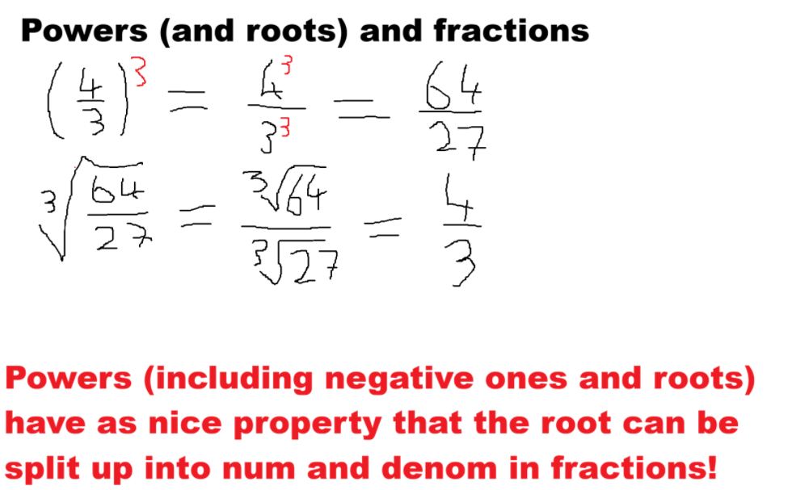

Slide 21
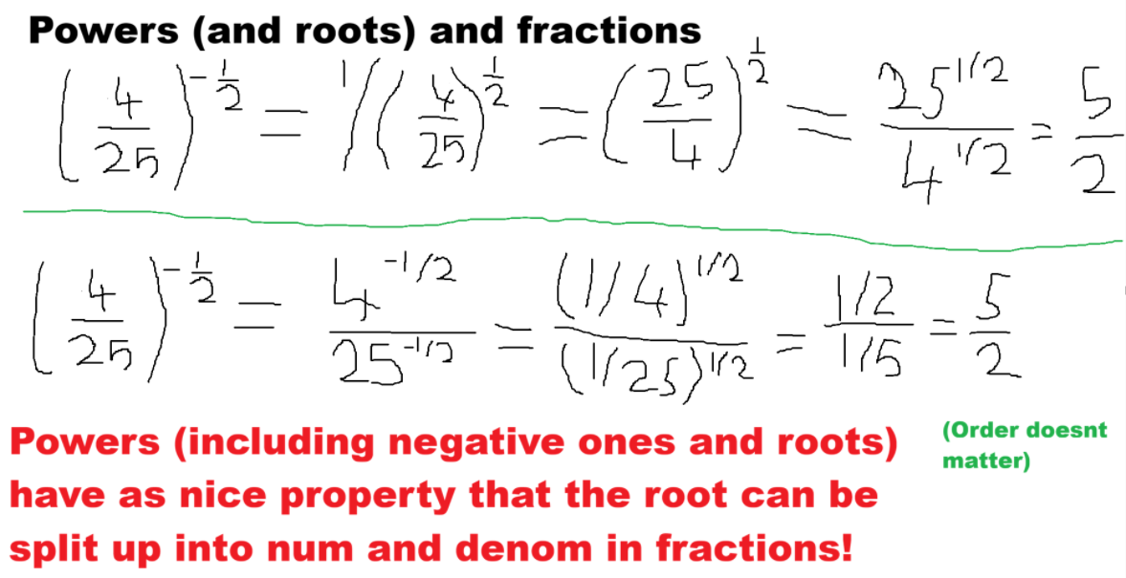

Slide 22
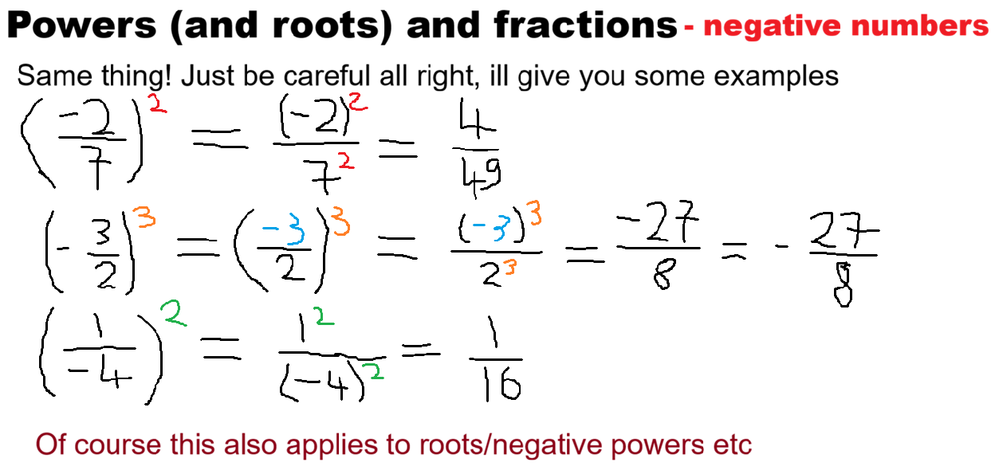

Slide 23
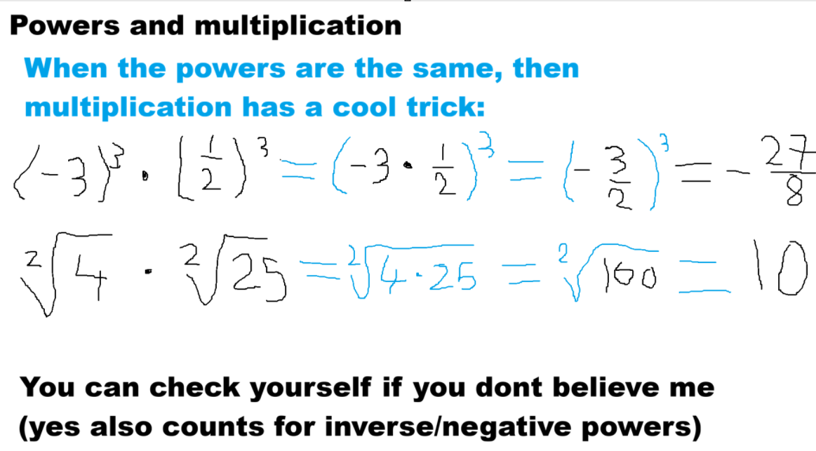

Slide 24
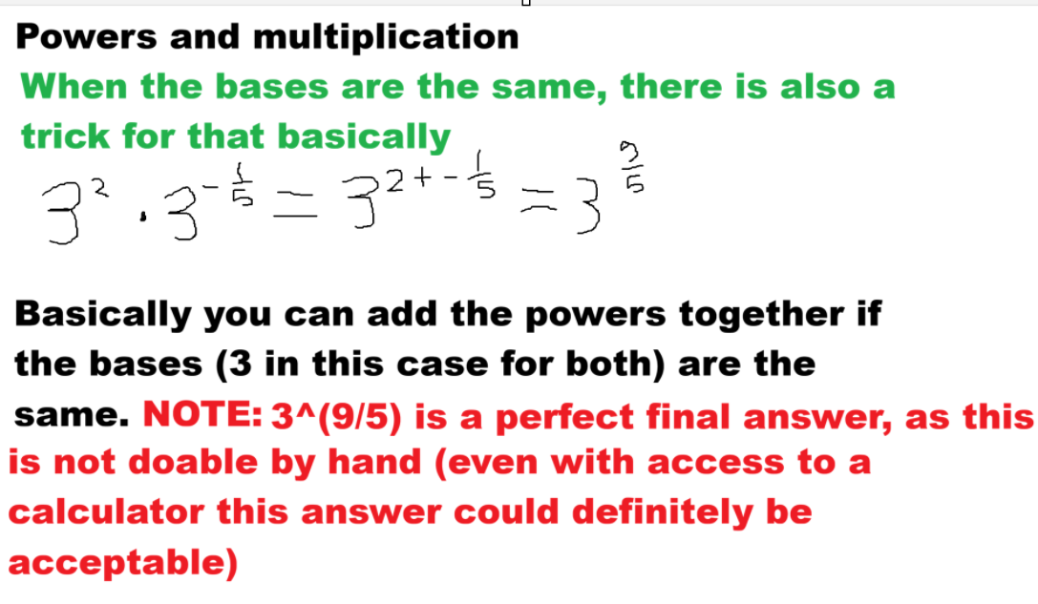

Slide 25
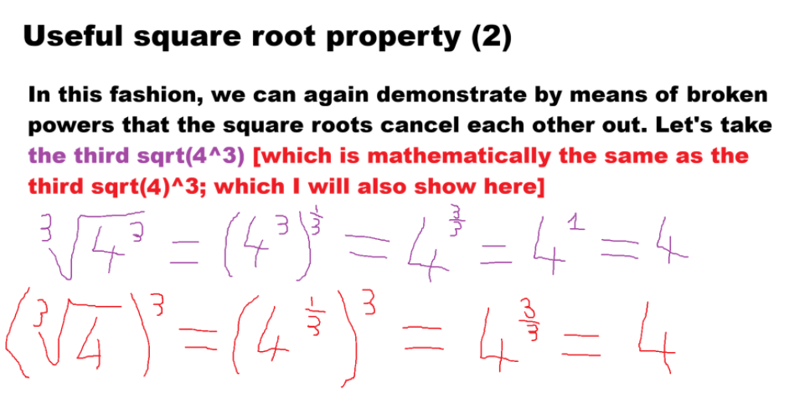

Slide 26
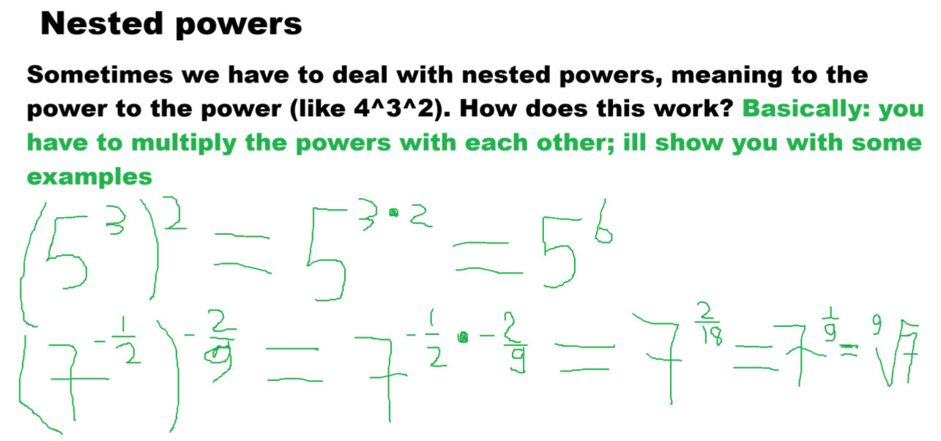

Slide 27
- REVISION
- IMPORTANT: The nested power rule only seem to work for positive bases! - So (3^2)^(-5/2) works fine as without the power rule [green 3 is the base here], you get (using BIDMAS): (3^2)^(-5/2) = 9^(-5/2) = (1/9)^(5/2) = (sqrt(1)/sqrt(9))^5 = (1/3)^5 = [(1^5)/(3^5)] = 1/243 and with the nested power rule you get: (3^2)^(-5/2) = 3^(2 * -5/2) = 3^(-10/2) = 3^(-5) = (1/3)^5 = [(1^5)/(3^5)] = 1/243 so those are the same indeed
- But with a negative base like -2, this trick doesnt work anymore (so sorry for not saying that earlier). I will show you with the example: ((-2)^2)^(-3/2), where I will first do it without: ((-2)^2)^(-3/2) = 4^(-3/2) = (sqrt(4))^(-3) = 2^(-3) = (1/2)^3 = [(1^3)/(2^3)] = 1/8 -> CORRECT ANSWER and with the nested power rule now: ((-2)^2)^(-3/2) = (-2)^(2 * -3/2) = (-2)^(-3) = (1/-2)^3 = [(1^3)/((-2)^3)] = 1/-8 = -1/8 !! -> WRONG ANSWER (YOU CAN CHECK WITH YOUR CALCULATOR!!!)
- Why its wrong? Probably because of the root function: sqrt or ^(1/2) or ^(1/4) etc only displaying positive results: like both 3^2 = (-3)^2 = 9 but in your calculator, check for yourself that sqrt(9) = 3 and not -3! REMEMBER THIS!!!
- So if you see a negative base, solve it without the nested power rule!!

Slide 28
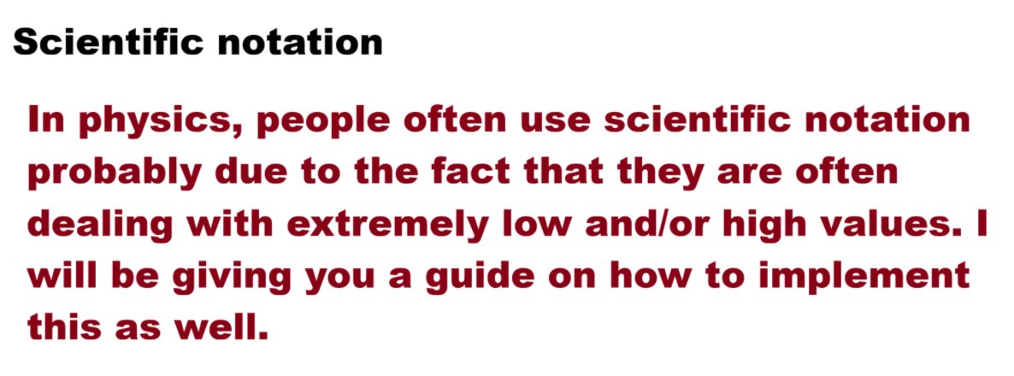

Slide 29
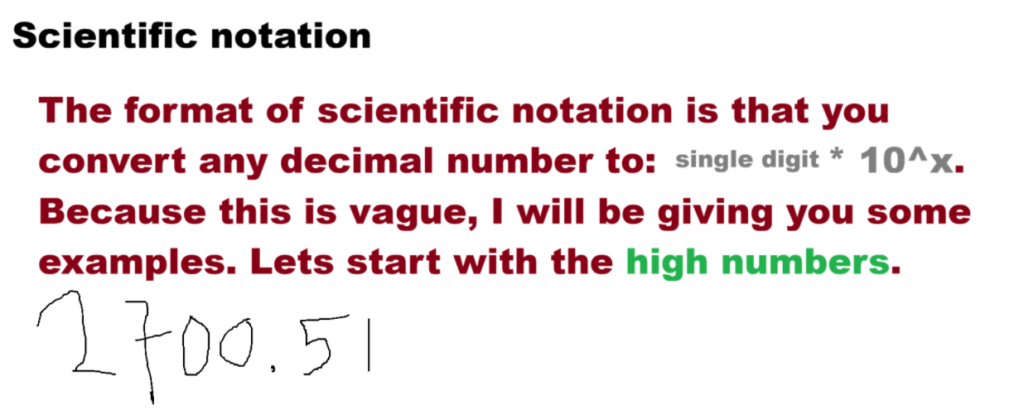

Slide 30
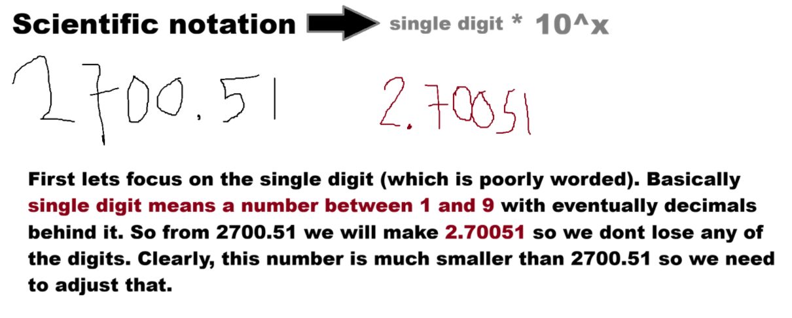

Slide 31
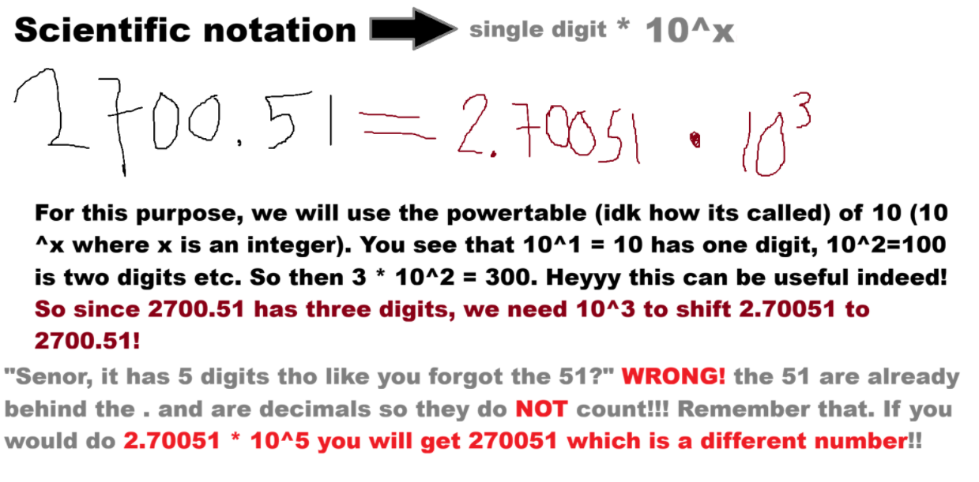

Slide 32
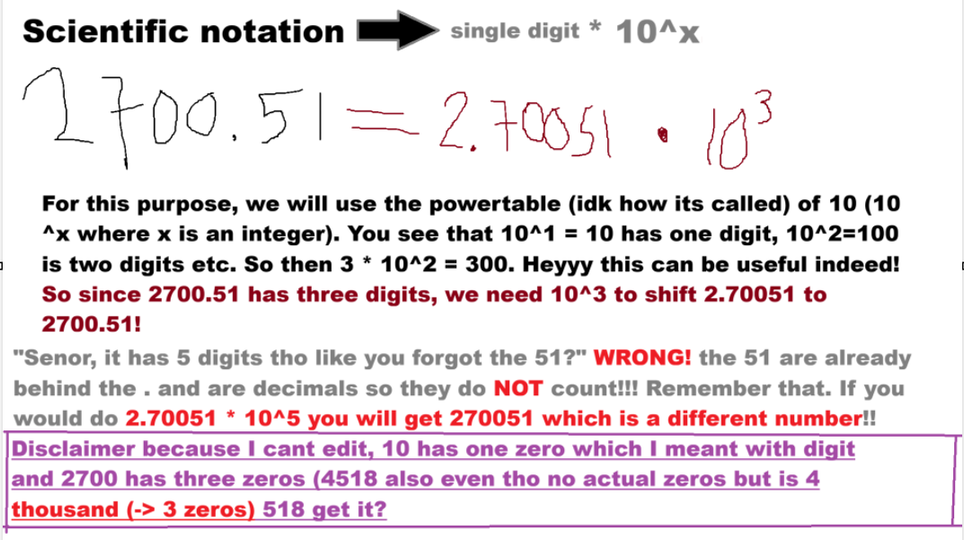

Slide 33
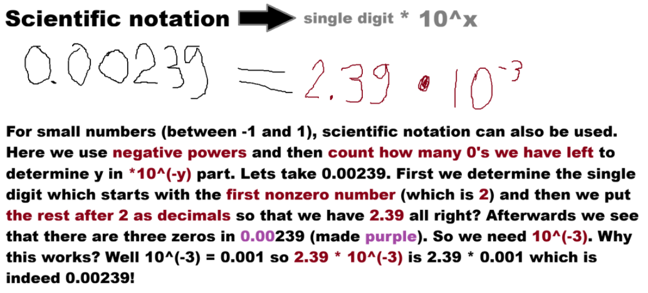

Slide 34
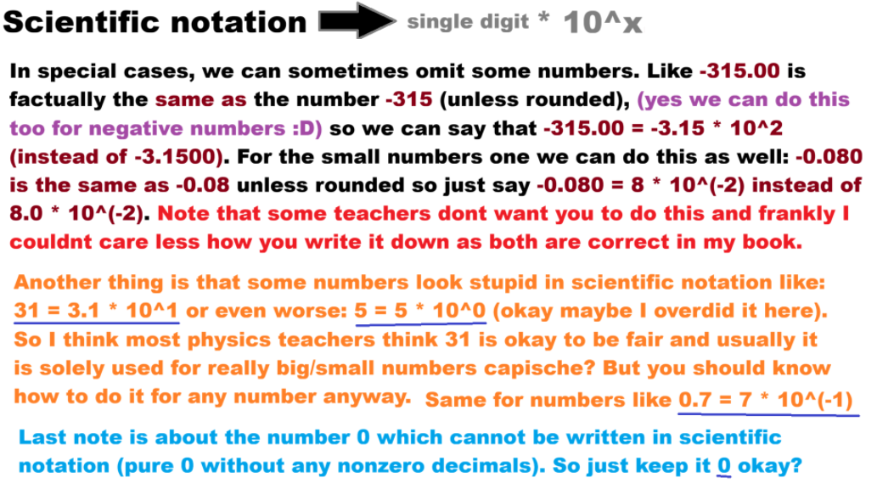

Slide 35
BIDMAS
In maths, you have an order of operation that we adhere to and this order is called BIDMAS
It works as follows: 1. Brackets i.e. () 2. Indices (powers ^ and roots √) 3. Division (÷) and Multiplication (×) 4. Addition (+) and Subtraction (-)
In here, division and multiplication are seen as equal (no preference among the two) and addition and subtraction likewise
In case of no preference, we work from left to right in maths

Slide 36

BIDMAS
Lets go over an example:
Note that I rarely use $÷$ because its considered wonky notation in maths, but it works well to demonstrate BIDMAS in practice. In this case I mean “… (5+4)/3 …” with it. Also the dot ($∙$) is of course the commonly used multiplication sign in maths and is often preferred over the ×.
$$3+6∙\left(5+4\right)÷3−2^{4}+\sqrt[3]{27}$$

Slide 37

BIDMAS
$$3+6∙\left(5+4\right)÷3−2^{4}+\sqrt[3]{27}$$
- Step 1 will be looking at Brackets. We see this part in particular: $\left(5+4\right)$ which we will have to focus on first. Well (5+4)=(9) so we will place that in here [we also get rid of the brackets around 9 because we simplified what is in it]:
$$3+6∙9÷3−2^{4}+\sqrt[3]{27}$$

Slide 38
BIDMAS
$$3+6∙9÷3−2^{4}+\sqrt[3]{27}$$
- Step 2 will be looking at Indices. We see two of them: 2^4 and 27^(1/3) which we can simplify. We know that 2^4=16 and 27^(1/3)=3, so we will substitute those in the equation now.
$$3+6∙9÷3−16+3$$

Slide 39
BIDMAS
$$3+6∙9÷3−16+3$$
- Step 3 concerns Division and Multiplication. So this is about the elements 6*9 and 9/3. However these elements are next to each other so looped: 6*9/3. But division and multiplication are equal right? Yes. Okay so what now?
- Remember! Left to right, so we will first solve 6*9=54 and plug that in:
$$3+54÷3−16+3$$

Slide 40
BIDMAS
$$3+54÷3−16+3$$
- Subsequently, we solve 54/3 = 18 [one could use tail division for this if you didnt know or the fact that 27/3 = 9 and 54/3 = 2 * 27/3 = 2*9=18; thats how I did it anyway] and plug that in:
$$3+18−16+3$$

Slide 41
BIDMAS
$$3+18−16+3$$
We have arrived at the last stage: Addition and Subtraction. We just solve from left to right here, so you could also see it like this: (((3+18)-16)+3). [but dont please just remember left to right].
- Anyhow, 3+18=21, then 21-16=5 and lastly 5+3=8 and voila we are have found our final answer:
$$8$$

Slide 42

Notes on BIDMAS
Inside the brackets, the BIDMAS also holds like for example in: $3^{3}(5−6^{2})$, you first simplify 6^2=36, then do 5-36=-29, afterwards you do 3^3=27 and then do 27 (3^3) * -29 (result from brackets).
A fraction like $\frac{1}{3}$ is mathematically similar to 1÷3 so take this into account when doing BIDMAS!
In case of multiple brackets like 2+(3-(5+7)), do the (most) inner brackets first! So first do (5+7)=12 such that you get 2+(3-12) and then the outer brackets (or the one that is the most inner now)

